Slide 1
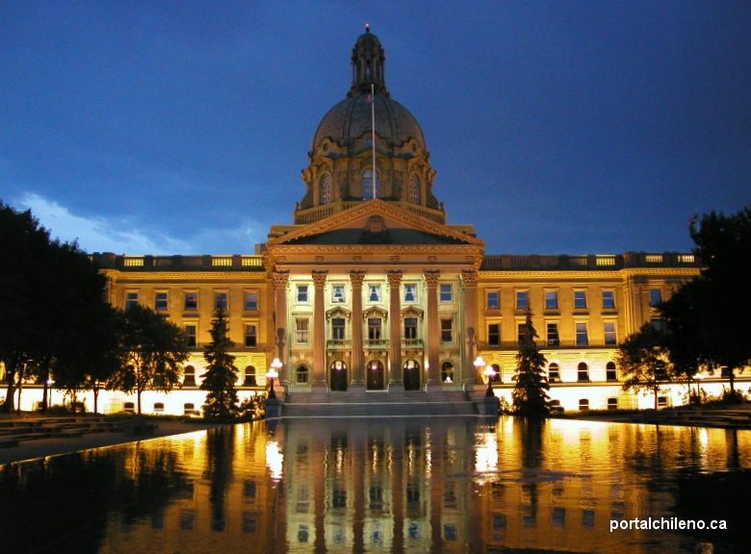
Alberta Legislature
What’s it all about

Slide 2
Calgary – divided into 14 Wards elects 14 councilors- - they represent us/their wards at city council.
Alberta divided into 87 constituencies – elects 87 MLA’s to represent their constituents.

Slide 3
Let’s Party??? There are 9 registered political parties in Alberta MLA’s belong to a political party.
Alberta First Party/ formally separation party of Alberta

Slide 4
The political party with the most elected Members of the Legislative Assemble (MLA) forms the Alberta Government
This is the party that will determine government policies until the next election.
Rachel Notley is the leader of the NDP in Alberta– she then becomes the Premier of Alberta.

Slide 5
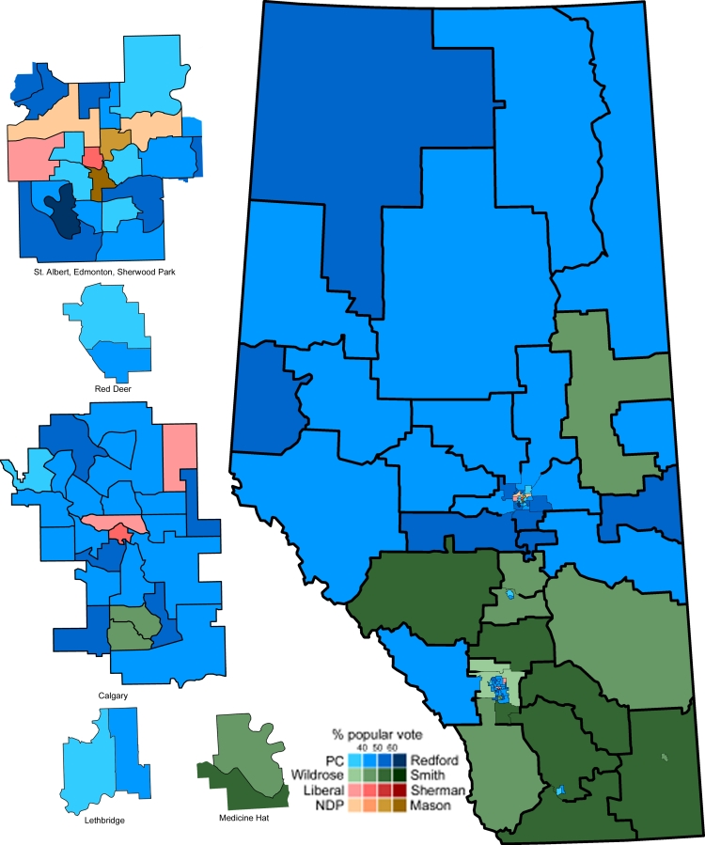
Every MLA who won in their constituency will become a Member of the Legislature Assembly.
MLAs are divided up as:
Private Members:
MLA who is not a Cabinet Minister
Debate and usually support government bills
Cabinet Ministers:
A MLA who is head of a ministry
Finance , energy. Education, human services, jobs, municipal affairs… to name a few – the Premier picks the cabinet ministers

Slide 6
2015 general election

Slide 7
The flip after the 2015 election

Slide 8
Provincial:
Schools, education, health care, social assistance, natural resources, licenses
Municipal:
Libraries, snow removal, transit, building permits, property taxes, water, waste management
Federal:
National security, defense, military, international relations, citizenship and immigration, money, banking, postal service
Who Does what?
http://youtu.be/AVE3OsR5W-0
What does each level of Government do?
http://youtu.be/BwbnUkxcrV8
Homework: answer the following questions in your student handbook
If you were Premier, what would be some of your duties?
Why do Alberta citizens elect MLAs?
What do these people do for us in the Legislature?
Shared:
Roads, laws, police, environment, parks, tourism
Where do the government and MLAs get ideas for new laws?
Why do Alberta citizens elect MLAs?

Slide 9
How a Bill becomes a Law
http://youtu.be/yzflLqk0ksM
http://youtu.be/x_Vm7oaoOuU

Slide 10
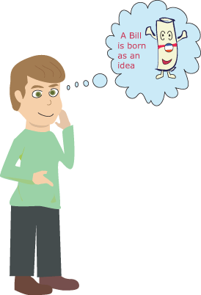
Introduction of a Bill
A law starts with an idea and when an idea is presented to the legislature, it is in the form of a bill.
A bill goes through several stages before becoming a law. These stages give all members and voters a chance to study and make their views known. Many suggestions may be made about how to improve the bill.

Slide 11
The member who is proposing to make a bill law motions to introduce it to the other members. After being introduced, it goes through a first reading which explains its objectives. Then, MLAs decide whether to accept the bill for future debate. If the answer is yes, then it is assigned a number and scheduled for a second reading. Each member gets a copy of the bill.
First Reading
Here, members discuss the bill’s details further on why it should or should not become a law. After the debate, the MLAs vote to let the bill proceed to the next step.
Second Reading
I, the bill, am sent to a standing or select committee for a more detailed study. I can be at the committee stage for a few days or up to several months! Each of my sections is discussed. A vote is taken on each section and there can be amendments or changes. The committee will then report to the House on what they have decided about me.
Committee of the Whole

Slide 12
This is the last debate about the bill. After the debate is over, the Speaker calls for a final vote about making the bill a law. If there is a majority, the bill goes to the next step in becoming law, Royal Assent.
Third Reading
Royal Assent
The bill is passed to the Lieutenant Governor, who through a special ceremony signs and affixes the Great Seal of Alberta. This is called Royal Assent and officially makes the bill law.
Lois Elizabeth Mitchell – June 2015

Slide 13
Let’s review
http://youtu.be/x_Vm7oaoOuU
How a bill becomes a law

Slide 14
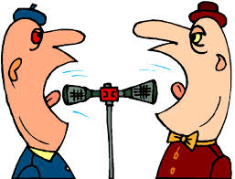
Let’s Debate!
Key components of a debate

Slide 15
Legislative debate is to consider a proposal for a new law
What debate accomplishes
How a simple debate works
During a debate multiple ideas, opinions and possible solutions are expressed.
The process of debate bring these different ideas into the open and allows all sides to challenge each other and attempt to show why their position is better.
http://youtu.be/yV8zEjgZ8VE Rick Mercer
A simple debate has one group supporting an issue and one group opposing it.
A moderator runs the debate, this person is nonpartisan
the moderator recognizes whose turn it is to speak and tells them when their time to speak is over.
In the Legislative Assembly the moderator is the Speaker or the Chair of Committees.

Slide 16
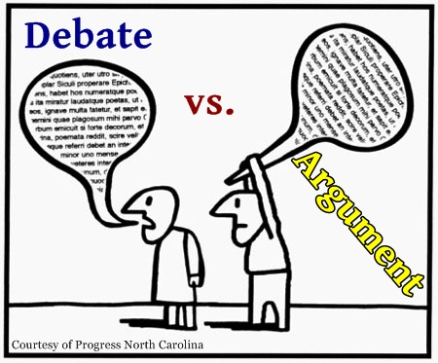

Slide 17
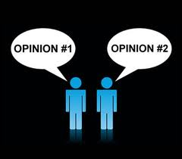
Key components of a debate
Opening statements
Each side has an opportunity at the beginning of the debate to briefly state one or two major reasons for supporting or opposing the issue (or Bill).
Supporting arguments
Each side uses examples from their research as evidence that their position on the issue is the best.
This happens during second reading and during Committee of the Whole

Slide 18
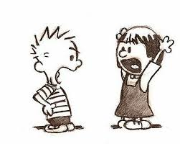
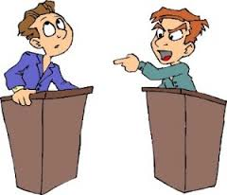
Rebuttals
Each side responds to specific points the other side has made in order to defend their own position. During debate it is very important for each side to listen to the other and to think about what the other side has just said.
Rebuttals will happen during Committee of the Whole.
Closing statements
Each side summarizes their major points. They may wish to restate a strong supporting example that makes their position especially convincing.
This will happen in our third reading of the Bill.

Slide 19
THINK, PAIR SHARE
LET’S REVIEW
WORK IN PAIRS AND COMPLETE THE COMPONENTS OF DEBATE CHART ON PAGE 8 OF YOUR STUDENT HANDBOOK
http://www.youtube.com/watch?v=t-0R9BUuptA

Slide 20
The Legislative Assembly
Daily Routine, Ceremony and People
http://www.youtube.com/watch?v=t-0R9BUuptA

Slide 21
Daily Routine in the Legislative Assembly
Pair, share and write
Page 11 – Read with a partner and answer the question on the bottom of the page.

Slide 22
Procession
The sitting begins with the chamber doors opening to reveal the Sergeant-at-Arms carrying the ceremonial Mace into the chamber and escorting the Speaker of the Assembly. Everyone in the chamber stands for the Speaker’s procession. The Speaker is followed by the Clerk of the Legislative Assembly and the other table officers. The Sergeant-at-Arms lays the Mace at the end of the Assembly table with the crown of the Mace pointing towards the government members.

Slide 23
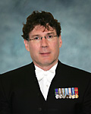
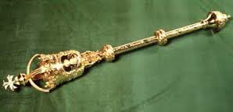
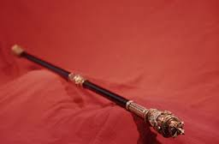
The Sergeant-at-Arms
Brian Hodgson
Carries the Mace
Head of security inside the chamber

Slide 24
Speaker of the Assembly Honorable Robert Wanner
The Speaker is an MLA who presides over debate in the chamber.
This person is responsible for enforcing the rules of the chamber and ensuring that all MLAs are treated fairly. The Speaker must serve all MLAs equally no matter which party they belong to. The Speaker does not normally vote on bills except in the case of a tie. The Speaker is also responsible for the Legislative Assembly Office, whose staff provide support for the MLAs and the Assembly as a whole.

Slide 25
Inside the House the clerk of the assembly
The Legislative Assembly Chamber is where the Assembly meets.
The Speaker sits at the head of the chamber.
Members of the governing party sit to the Speaker’s right.
Opposition members sit across from them.
Sometimes a government has such a large majority that there aren’t enough seats on the government side. Some of the government members would then have desks placed on the opposition side but separated by an aisle. In some cases, when the government has a minority of seats in the chamber, some opposition members may have to sit on the government side.

Slide 26
Lieutenant Governor
The Lieutenant Governor is the monarch’s representative. The Lieutenant Governor is not a member of the Assembly and only enters the chamber upon invitation.
This person grants royal assent to bills which have passed third reading. The Lieutenant Governor also opens and closes sessions of the Assembly, reads the Speech from the Throne and dissolves the Assembly for an election. (This is called dissolution.) The Lieutenant Governor also officially appoints the Premier and swears in the cabinet.

Slide 27
Clerk of the Legislative Assembly
Table Officers

Slide 28
Working together
In partners, with your student handbook and the separate seating plan of Chambers read and learn about the people and their roles who work in the Chamber during a sitting of the Legislative Assembly.
Complete the Chamber Matching Game
Be sure you are able to support your answers
Answer the question at the end of your booklet,
“… which roll would you choose? Why did you choose that role?

Slide 29
How the provincial government works
Reading from text book page 146

Slide 30
Go over each role
MLAs
Government MLAs
The premier
Cabinet ministers
Private government members
The chair of committees
Opposition MLAs
The leader of the Offical opposition
Members of the opposition
Table offcers
The clerk of the assembly
The law clerk
Parliamentary counsel
The committee research co-ordinator
Sergeant at arms
pages
Hansard
The media

Slide 31
Let’s Make a New Law!!!

Slide 32
Developing a Bill Proposal for Debate Bill 501 The School uniform Act Group One
Proposal (Bill)
What should be done?
Require all students to wear school uniforms
Who is most concerned about it?
Parents, students, principals, teachers.
What is the issue?
Creating a feeling of equality and respect in schools.

Slide 33
Developing a Bill Proposal for Debate Bill 502 The Environmentally Friendly Schools Act Group two
Proposal (Bill)
What should be done?
Require all schools to be environmentally friendly
Who is most concerned about it?
Parents, students, principals, teachers, environmentalists, businesses
What is the issue?
Protecting the environment

Slide 34
Research
You will be divided up into interest groups – supporting or opposing the Bill
– Committee of the Whole- You will not have much time research your issue using different resources
Develop key points for why you oppose or support the Bill or why you oppose or support certain aspects of the Bill
Come back together and share
Committee of the Whole - Prepare rebuttals
These arguments will be used later in our Mock Legislature simulation.

